Slide 1
Attenuation

Slide 2
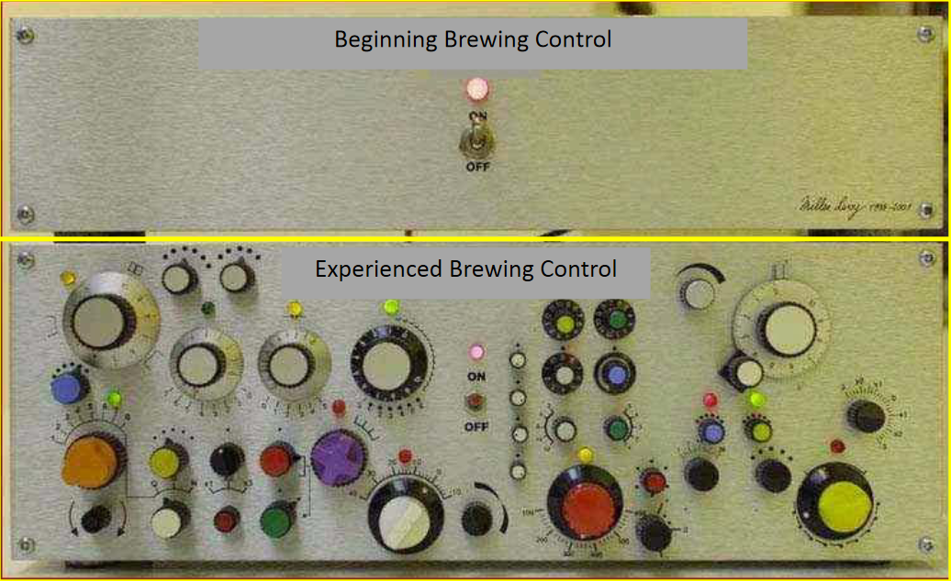
So True…

Slide 3
Before we begin
Having issues with over carbonated bottles, or beers that are too sweet? Attenuation issues may be what’s causing it.
You’ll need to start with some good gravity readings, OG and before bottling at least. If you don't take gravity readings, then you won't know if you've attenuated fully.

Slide 4
Apparent Attenuation (AA)
AA = (Original Gravity – Final Gravity)/(OG-1)
AA = (1.050 – 1.011)/(1.050 -1)
AA = (.039)/(.050) = .78
AA = 78%
*Or just use a calculator ☺

Slide 5
What happens if your attenuation is off?
Beer is too sweet – too much remaining sugar
Not hoppy enough – residual sugars counteract the hop bitterness
Fuller than expected mouthfeel
Sweeter Finish than expected
Two Words:
  Bottle Bombs!

Slide 6
What effects Attenuation
Primary Factors:
Fermentability of the wort
Performance of the yeast

Slide 7
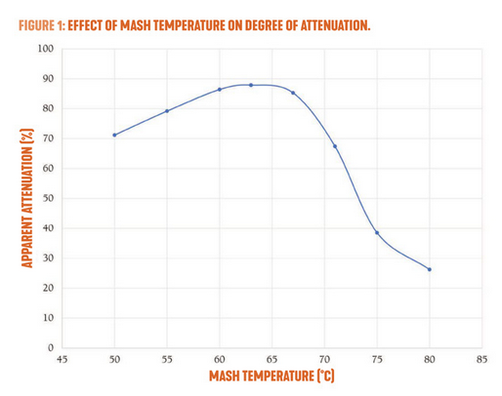
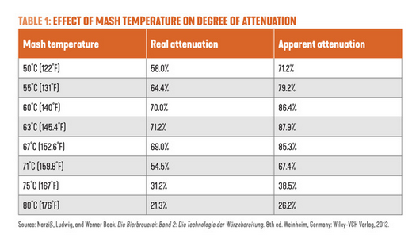
What effects Attenuation - Fermentability
Mash Temperature – Lower ranges give you a more fermentable wort
Missing your mash temp or not mashing long enough can leave behind unconverted starches.
November / December ???? Zymurgy, pg 25

Slide 8
What effects Attenuation – Yeast Performance
Primary Factors:
Yeast Strain Choice – Some attenuate more than others, some stall, some are very, very hungry.
Poor Yeast Health / Low pitching rate
  Not Enough yeast to do the job (Under pitching)
  Yeast may be slower than expected
  Good Oxygenation is important
  Yeast nutrition (especially zinc) is important
  Stable temperatures within yeast strain’s range
    Too hot – off flavors
    Too low – slow / stalled fermentation

Slide 9
Fast Fermentation test
Take a wort sample before pitching yeast
  Enough for a hydrometer reading
Add a good amount of yeast to it (overpitch)
Keep it warm
Agitate it frequently
Take gravity reading after 36 – 48 hours
This reading should be the final gravity of your full batch.

Slide 10
Help! My fermentation stalled!
Take a gravity reading – Is it stalled or finished? Compare your readings the yeast’s expected attenuation range.
Rouse your yeast
  Swirl the wort in the fermenter
  Maybe rack to secondary
Try pitching some more, active yeast
Wait … give it another week then take another gravity reading.

